Slide 1

Leveraging AWS Services
Enhancing IT Infrastructure and Software Development
- Priyanshu Dhyani

Slide 2

Introduction to AWS Services
Overview of AWS and its importance in modern IT infrastructure and software development.
Brief introduction of the services covered in the presentation.

Slide 3

Amazon EC2 - Elastic Compute Cloud
Description: Resizable compute capacity in the cloud.
Use Cases: Hosting web applications, running backend servers, batch processing, scientific computing.
Example: Airbnb uses EC2 to handle its dynamic workloads and scale according to demand.

Slide 4

Amazon S3 - Simple Storage Service
Description: Scalable object storage for data backup, archival, and analytics.
Use Cases: Data backup and restore, content storage and distribution, data lakes for analytics.
Example: Netflix uses S3 to store and stream large volumes of video content to its global user base.

Slide 5

Amazon RDS - Relational Database Service
Description: Easy setup, operation, and scaling of a relational database in the cloud.
Use Cases: Running transactional databases, web and mobile applications, data warehousing.
Example: Expedia uses RDS for reliable and scalable database solutions to handle travel bookings.

Slide 6

AWS Lambda - Serverless Computing
Description: Run code without provisioning or managing servers.
Use Cases: Real-time file processing, data validation and transformation, backend services.
Example: Coca-Cola uses Lambda to manage their vending machine inventory and process sales data in real-time.

Slide 7

Amazon VPC - Virtual Private Cloud
Description: Provision a logically isolated section of the AWS cloud.
Use Cases: Hosting secure web applications, extending corporate data centers, isolated environments for sensitive workloads.
Example: Financial institutions use VPC to ensure secure and compliant networking environments

Slide 8

Amazon CloudFront - Content Delivery Network
Description: Securely delivers data, videos, applications, and APIs globally with low latency
Use Cases: Delivering websites and web applications, streaming video and audio content, distributing software updates.
Example: Amazon Prime Video uses CloudFront to deliver high-quality video content to users around the world with low latency

Slide 9

Benefits and Challenges of AWS Services
Benefits: Scalability, flexibility, cost-effectiveness, integration with other AWS services.
Challenges: Managing instances and costs, ensuring security configurations, complexity of setup and management.

Slide 10
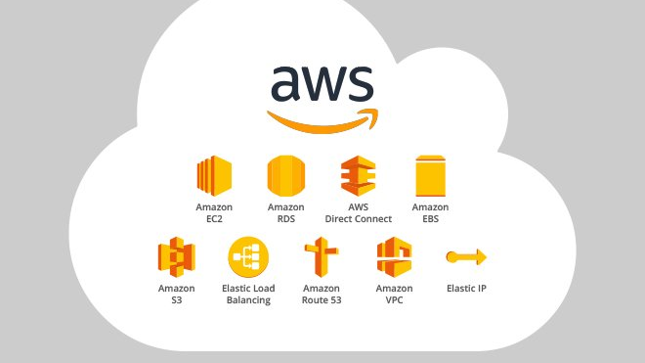
Thank You

